Slide 1
Characterizing the Geometry and Topology of RNA
Christine Wiersma
Mentor: Dr. Wilma Olson
DIMACS REU
Rutgers University
July 17, 2015

Slide 2
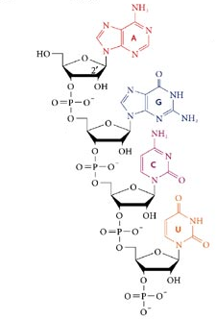
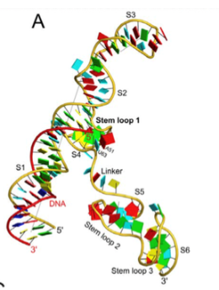
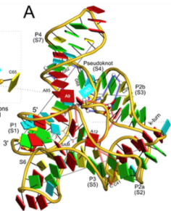
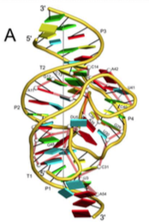
RNA Background
Nucleic Acid
Composed of nucleotides
Strand twists and bends allowing nucleotides to interact and create a 3D structure
Rana TM. 2007. Chemical and structural features of RNA and DNA helices. Nature Reviews Molecular Cell Biology. Internet.
Lu XJ, Bussemaker HJ, Olson WK. DSSR: an integrated software tool for dissecting the spatial structure of RNA. Preprint.
Lu XJ, Bussemaker HJ, Olson WK. DSSR: an integrated software tool for dissecting the spatial structure of RNA. Preprint.
Lu XJ, Bussemaker HJ, Olson WK. DSSR: an integrated software tool for dissecting the spatial structure of RNA. Preprint.

Slide 3
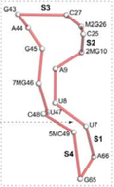
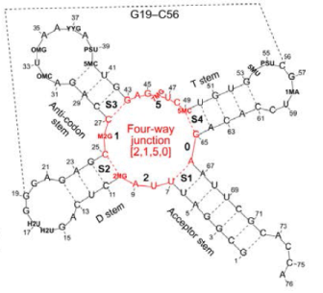
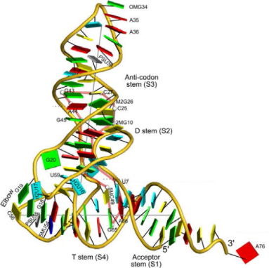
RNA Junctions
Lu XJ, Bussemaker HJ, Olson WK. DSSR: an integrated software tool for dissecting the spatial structure of RNA. Preprint.
Lu XJ, Bussemaker HJ, Olson WK. DSSR: an integrated software tool for dissecting the spatial structure of RNA. Preprint.
My 3D structure of the tRNA junction in a different orientation

Slide 4
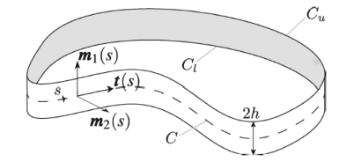
Ribbon Structure and Material Frames
Ribbon: smooth characterization of RNA’s structure
Material Frames: Set of 3 normal vectors that define the curve.
Clauvelin N, et al. 2012. Characterization of the Geometry and Topology of DNA Pictured as a Discrete Collection of Atoms. J. Chem. Theory Comput. 1093. Print.

Slide 5
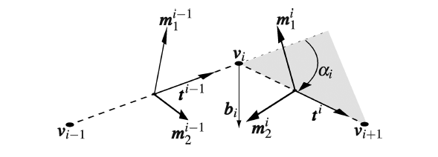
Discrete Curve
Discrete curve: Uses vertices connected by line segments as the centerline and a material frame to describe the rest of the curve.
I chose P and C1’ atoms to build this discrete curve
  P is part of the backbone and defines the centerline of the curve
  C1’ is the backbone atom directly connected to the bases
Clauvelin N, et al. 2012. Characterization of the Geometry and Topology of DNA Pictured as a Discrete Collection of Atoms. J. Chem. Theory Comput. 1093. Print.

Slide 6
Writhing Number
A measure of the distortion of the curve out of the plane
Sum of signed self-crossings

Slide 7
Total Twist
The total twist of one curve about another

Slide 8
Linking Number
Describes the entanglement of two closed space curves
Topological invariant
Notes:
Sum of all signed intersections that one of the curves makes with a surface bounded by the other curve

Slide 9
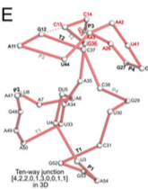
Future Work
Finish making the computations accurate
Use my code to analyze larger RNA molecules
  Twister Ribozyme
Lu XJ, Bussemaker HJ, Olson WK. DSSR: an integrated software tool for dissecting the spatial structure of RNA. Preprint.
Lu XJ, Bussemaker HJ, Olson WK. DSSR: an integrated software tool for dissecting the spatial structure of RNA. Preprint.

Slide 10
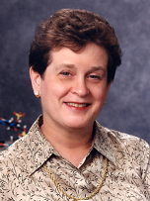
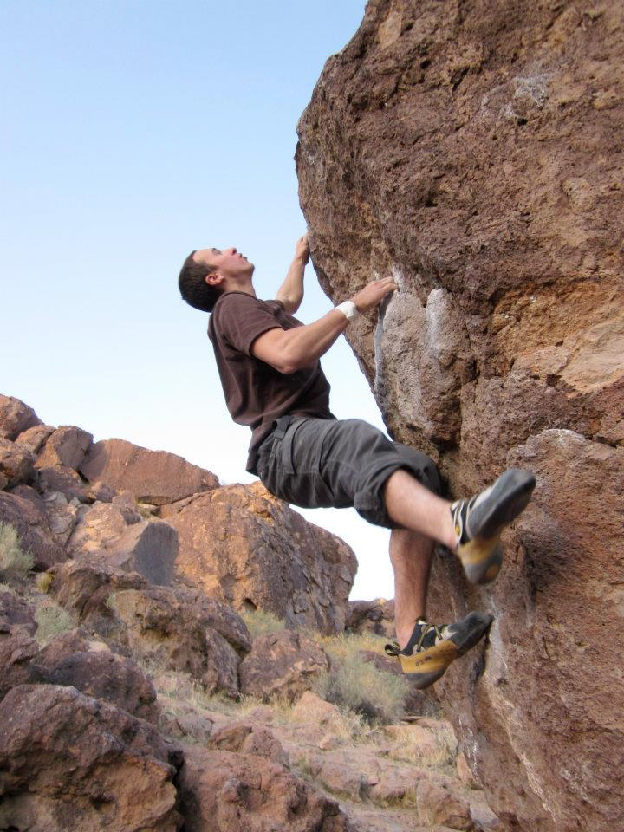
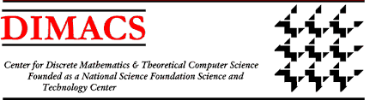






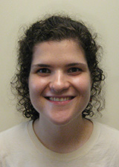
Acknowledgements
My Mentor:
Dr. Wilma Olson
Program Participants Who Volunteered Their Time to Help Me
Jan Voborník
Hadley Black
Program Coordinators
Richard Avelar
Andrew Wells
Dr. Eugene Fiorini
Matthew Charnley
Rebecca Coulson

Slide 11
Literature Cited
Brooker RJ. 2012. Concepts of genetics. New York, NY: The McGraw-Hill Companies, Inc. 225-242 p.
Clauvelin N, Olson WK, Tobias I. 2012. Characterization of the geometry and topology of DNA pictured as a discrete collection of atoms. J. Chem. Theory Comput. 8:1092-1107.
Lu XJ, Bussemaker HJ, Olson WK. DSSR: an integrated software tool for
dissecting the spatial structure of RNA. Nucleic Acids Research 2015; doi: 10.1093/nar/gkv716

